Slide 1
Counter Cash Objects

Slide 2
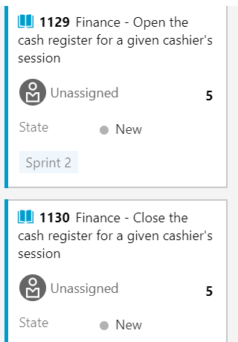
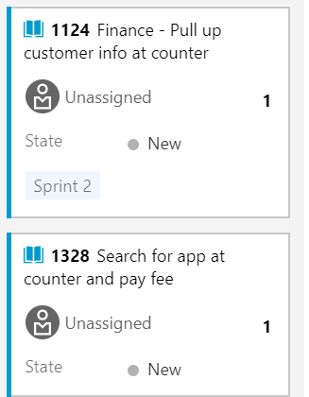
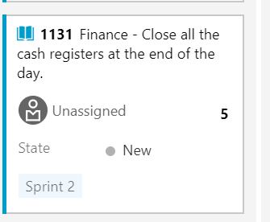
User Stories

Slide 3
Business process
Supervisor creates a cash register record for the day
Enters a beginning balance
Cashier #1 creates a payment batch record under that cash register record and includes her opening balance
This cashier conducts all her transactions (i.e. takes in payments as receipts records)
At the end of her shift, she enters closing amount in her cash register in the system and closes her payment batch record
Cashier #2 creates a payment batch record to record his transactions
Cashier #2 enters his closing amount and closes his payment batch record
Supervisor closes her cash register record after she enters her closing balance.

Slide 4
Payment Batch Object (child) OOTB
Description: Each cashier’s session
Along with OOTB fields, please add the following fields:
Total check + credit card
Total cash in register
Total
Opening balance
Subtotal
Total credit card receipts
Convenience fees
Total credit card
Cashier name (system generated)
Cash Register (Lookup to Cash Register object)

Slide 5
Cash Register Object (parent) Custom Object
Description: The cashier supervisor will open and close both of the cash registers at the end of the day
Relationships: This is the parent record of the payment batch records
Date is the relationship that links the corresponding Payment Batch Records
Fields
Cash Register (picklist: “Main”, “Back-Up”)
Cashier (free text field)
Date (system generated)
Opening cash balance (currency)
{Create fields from the attachment on the next slide: individual denomination fields}
Closing cash balance (currency)
Total Receipts {this is the total amount of receipts processed at the counter in a given day}
Administrator (lookup to user)
Over/short (currency)
Bag number (integer)
Status (Picklist: Open, Close, Sent to Bank)

Slide 6
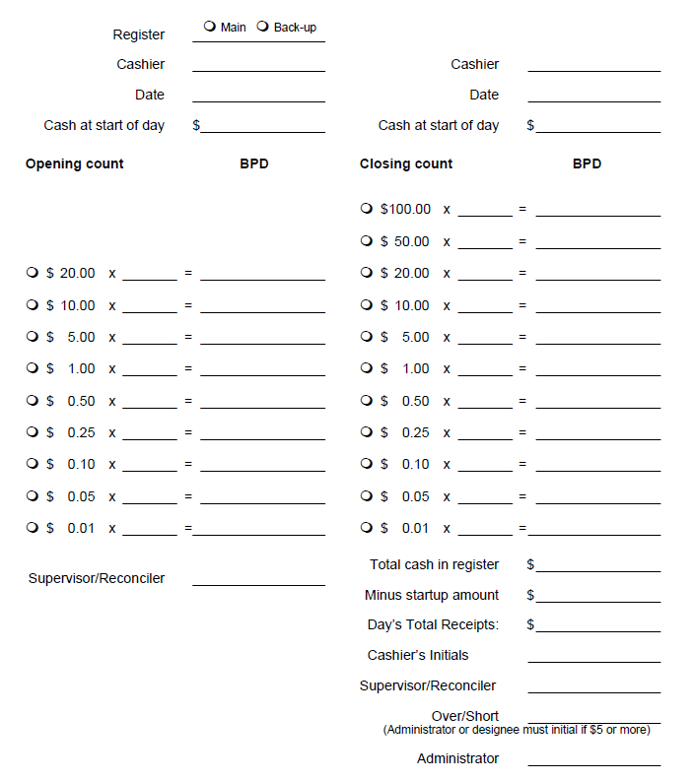
Sample Closing document
Individual denomination fields
Need to know how many bills there are in the cash register
Sum of amounts in the orange bracket
Sum of amounts in the blue brackets
{this is the total amount of receipts processed at the counter in a given day}
System-populated name of individual who ‘opened’ (created) the cash register record
Same as 5
(System generated cash total) – (Field #2)
Requirement: be able to capture the bills received and given during the course of the day.
2) add together those totals AND THEN subtract it from #2 to find the difference
The difference will show them if there is a difference between the amount of physical cash and the amount of cash they ‘should’ have
1
2
3
4
5
6
7

Slide 7
Example
5/2 – Cash register record
Beginning – supervisor creates cash register record (Day: has multiple sessions)
Joe – 9am-12pm – creates a payment batch record #1 (Joe’s session)
Annie – 12pm -2pm – creates a payment batch record #2
Lisa – 2pm -4pm – creates a payment batch record #3
End – supervisor closes the cash register record
1 Cash register record: multiple payment batch record

